Slide 1


Power System Survivability
Ship Electrical Distribution System Design
Revision of October 1, 2026
Dr. Norbert Doerry
http://doerry.org/norbert/MarineElectricalPowerSystems/index.htm
© 2026 by Norbert Doerry
This work is licensed via: CC BY 4.0 (https://creativecommons.org/)

Slide 2
Essential Questions
What is a design threat and a design threat outcome? | Understand
What are the three elements of survivability? | Understand
What is zonal survivability? | Understand
What is compartment survivability? | Understand
How should zone boundaries be determined? | Understand
How is survivability evaluated? | Understand

Slide 3
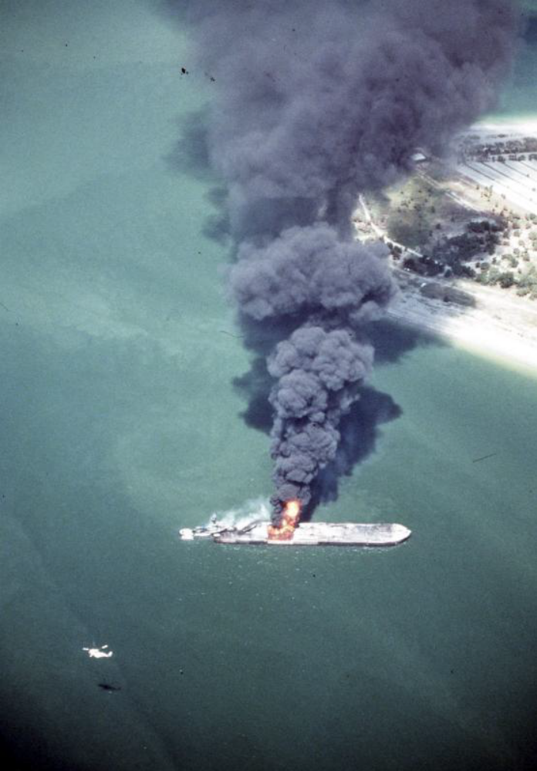
Design Threats / Design Threat Outcomes
Design threats
  threats that a ship is designed to address.
Design threat outcomes
  capabilities that the ship is expected to retain or restore following exposure to a threat.
Overmatching threats
  threats that may result in loss of the ship;
  the ship is not expected to retain capability after exposure to an overmatching threat.
USCG Photo: Public Domain

Slide 4
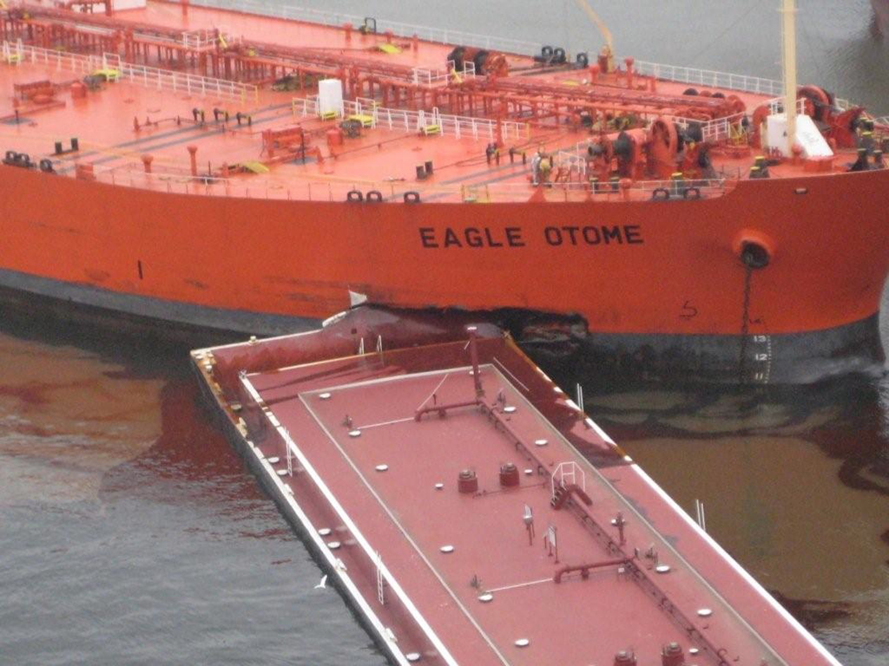
Elements of survivability
Susceptibility
  measures how well the ship avoids the threat such that the ship does not experience damage
Vulnerability
  measures how well the ship is able to retain capability when the ship is exposed to the threat and possibly damaged
Recoverability
  measures how well the ship is able to restore lost capability following exposure to a threat
USCG Photo: Public Domain

Slide 5
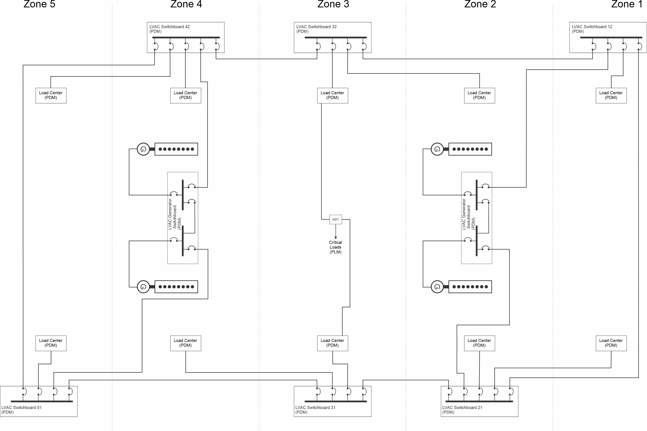
Zonal survivability
IEEE Std. 45.1
For a distributed system,
  such as the electrical distribution system,
  zonal survivability is the ability of the distributed system,
  when experiencing internal faults due to damage or equipment failure confined to adjacent zones,
  to ensure loads in undamaged zones do not experience a service interruption.
Because a bounding watertight subdivision transverse bulkhead can be damaged,
  zonal survivability assumes that two adjacent zones can experience damage due to a single event.
  The zones should be large enough such that no more than two zones are damaged due to a single event that the ship is expected to survive.”

Slide 6
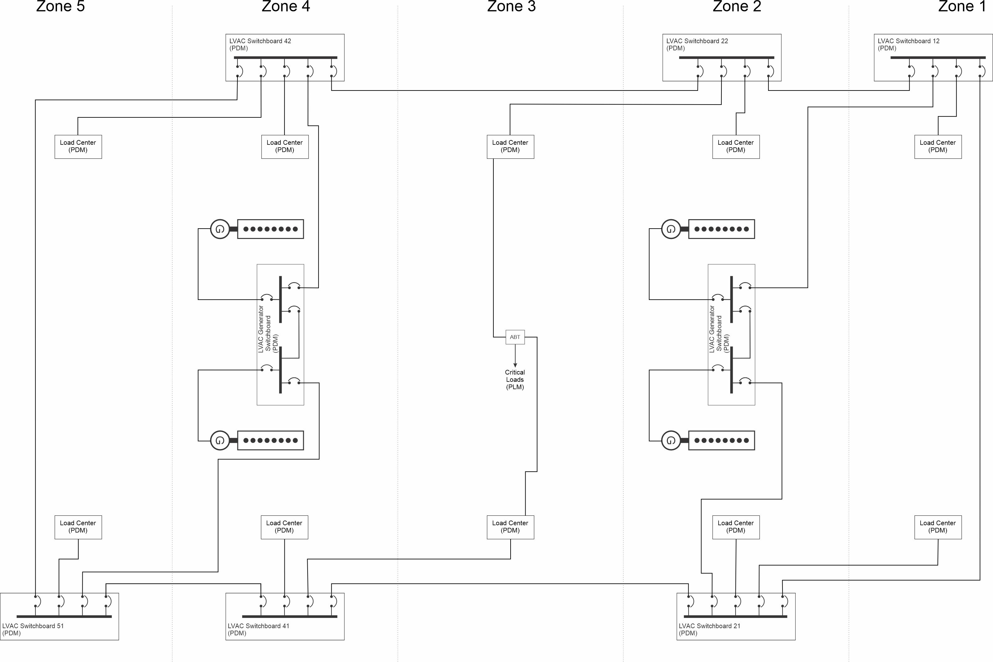
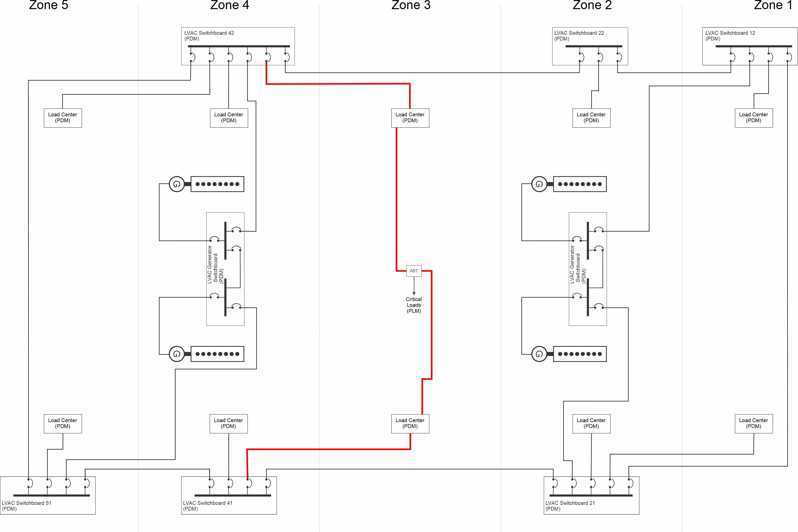
Compartment Survivability
IEEE Std. 45.1
Compartment survivability addresses the ability to recover loads within a damaged zone.
  In many cases, the damaging event does not damage all of the equipment within a zone.
  Critical equipment, such as the emergency loads, should have a means of restoring power to them if they are
    verified to be undamaged and
    will not cause a hazard if energized.
Compartment survivability is usually achieved by providing an alternate source for each distributed system that the load requires.
  For the electrical power system, switching from the normal to an alternate source is accomplished through either a manual bus transfer or an automatic bus transfer.
  On some naval ships, a casualty power system is provided to enable the rigging of temporary power cables from a load center or switchboard to the critical equipment
GOOD: Zone 3: Normal and alternate supplies from fore and aft
Bad: Zone 3: Normal and alternate supplies both aft
Loss of zone 4 causes loss of power to all loads in zone 3

Slide 7
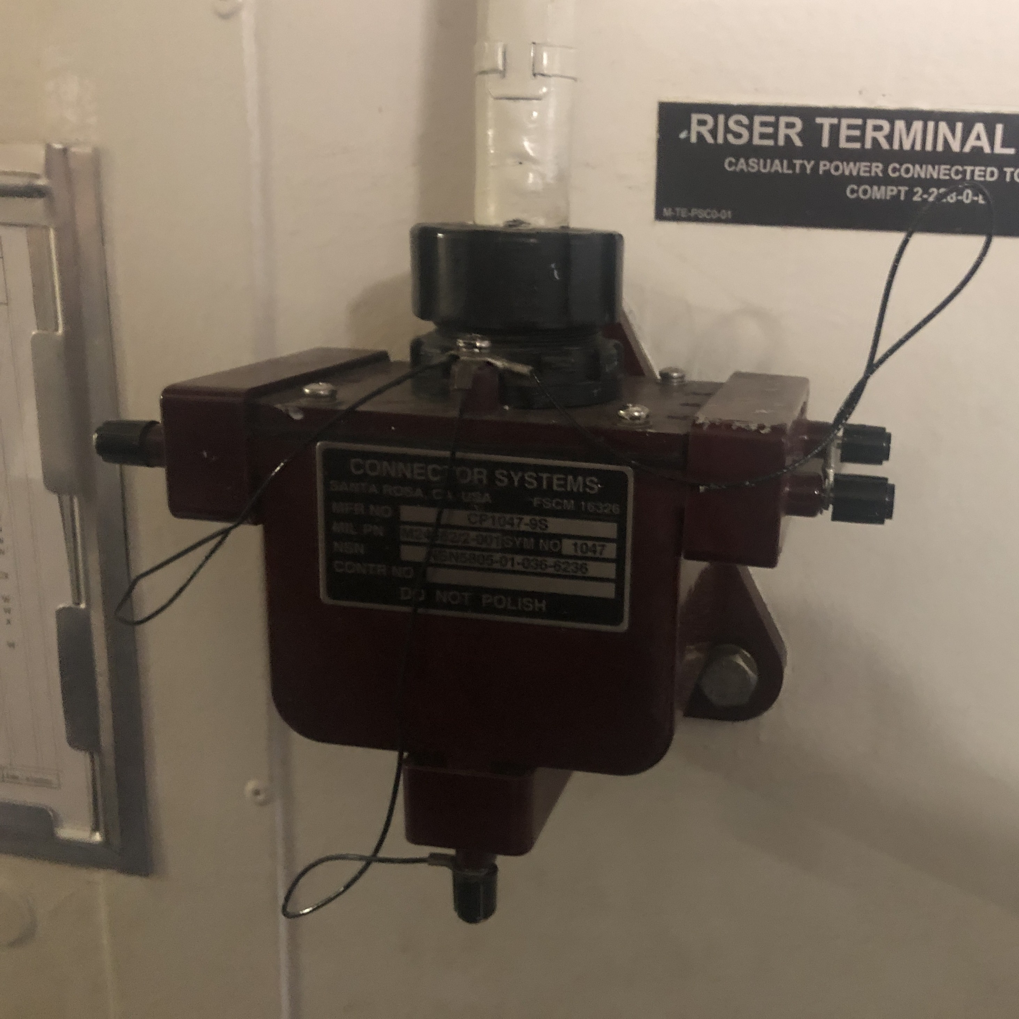
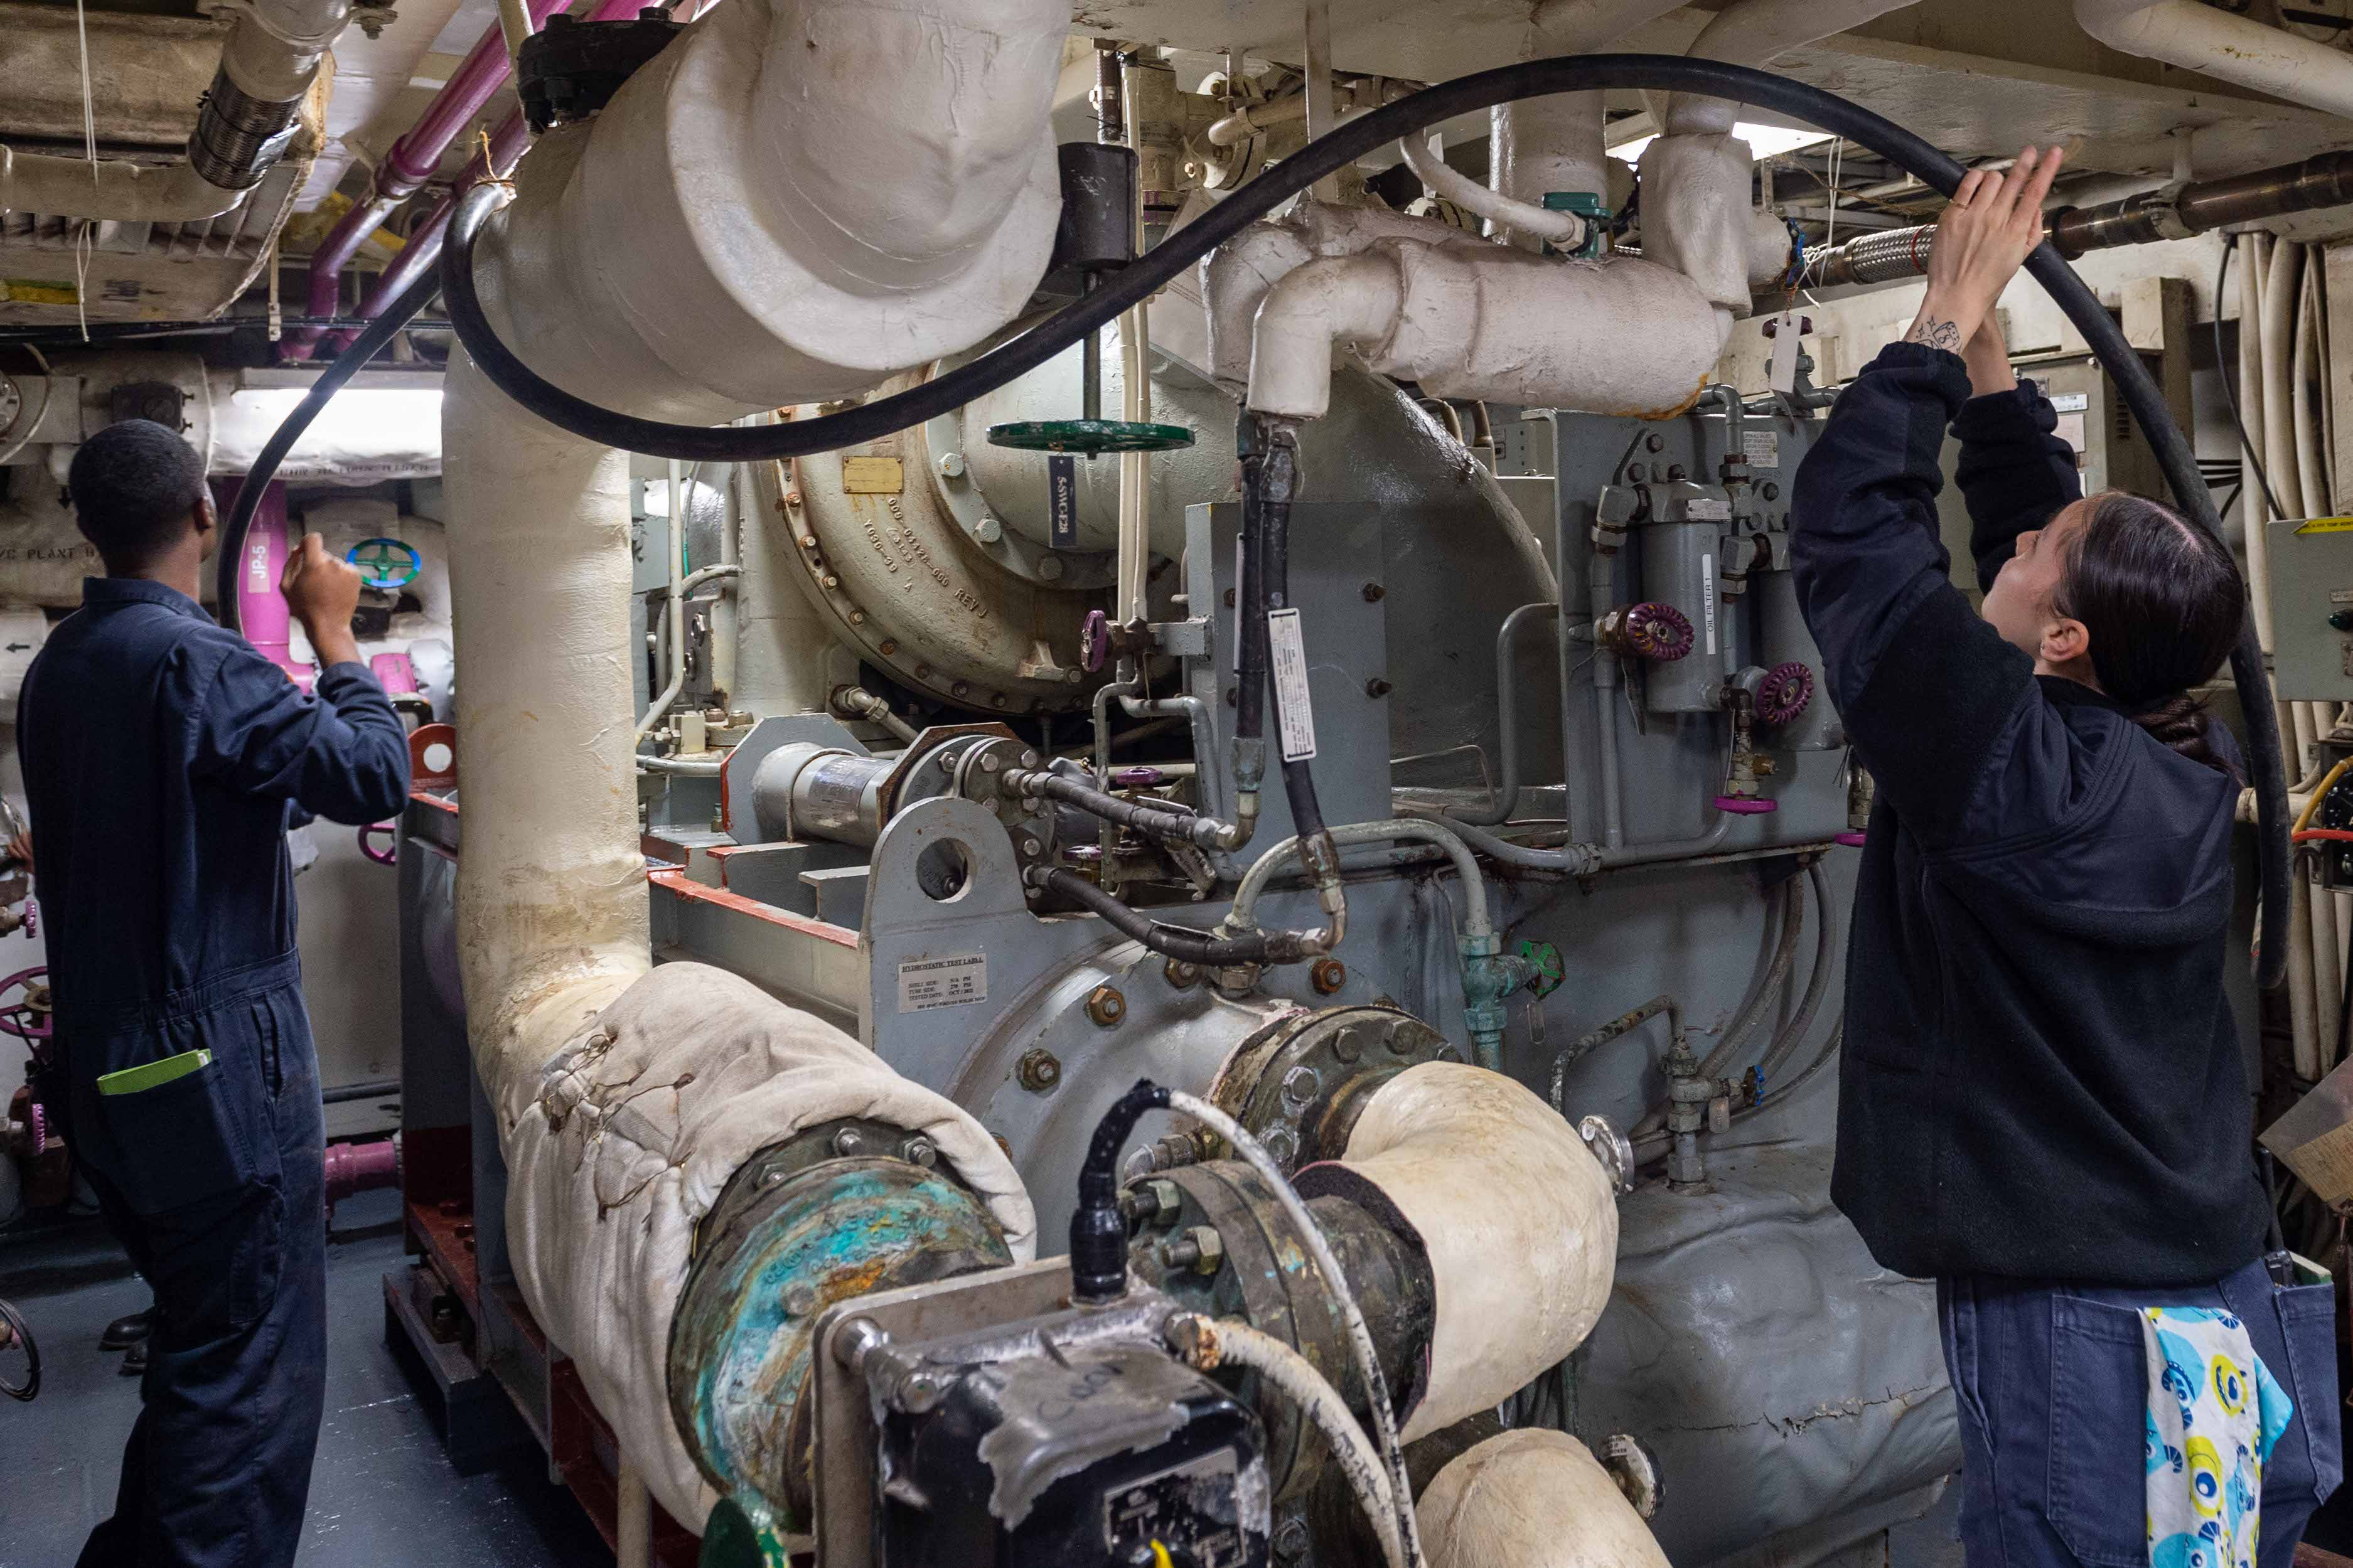
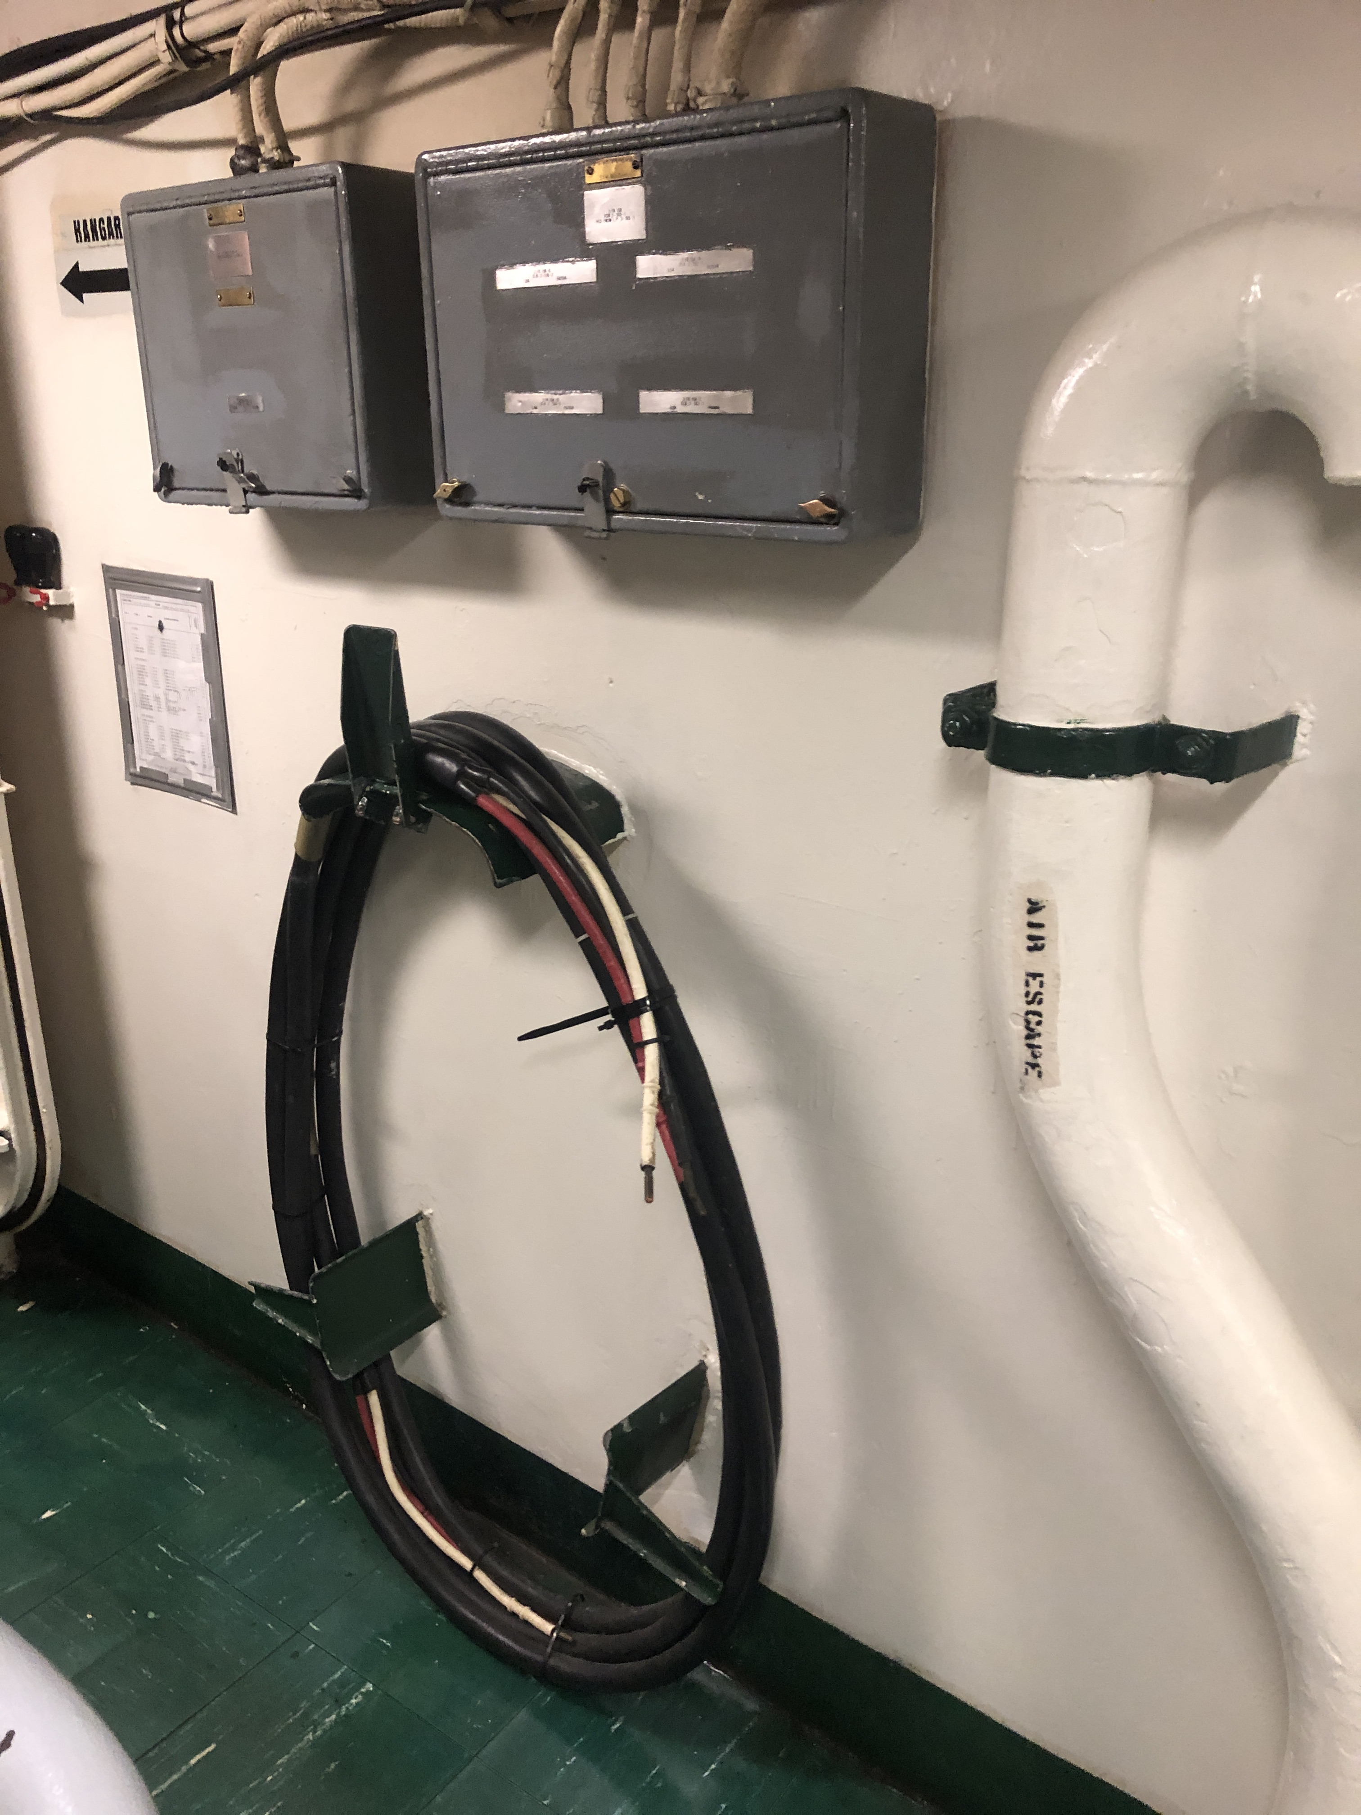
Casualty Power Systems
Photo by N Doerry: CC BY 4.0
Composed of
  Portable cables
  Permanently installed cables
  Connectors
  Bulkhead penetrations
Enables restoring power to emergency loads / loads designated for compartment survivability
Generally, only found on naval ships
USN Photo: Public Domain
Photo by N Doerry: CC BY 4.0

Slide 8
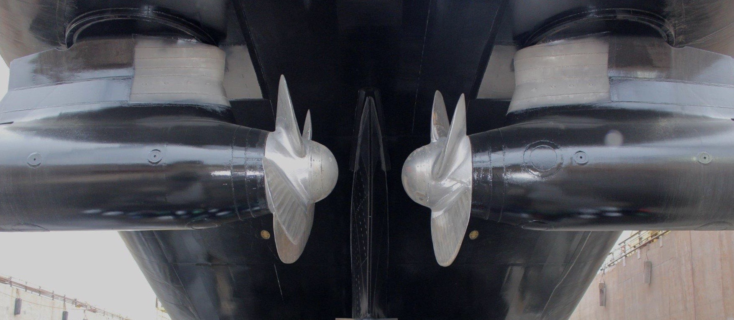
Dynamic Positioning
Dynamic positioning provides an inherent level of survivability for the propulsion system.
ABS Guide for Dynamic Positioning System
  “DPS-2 For vessels which are fitted with a dynamic positioning system which is capable of automatically maintaining the position and heading (Station Keeping) of the vessel within a specified operating envelope under specified maximum environmental conditions during and following any single fault, excluding a loss of compartment or compartments.”
  “DPS-3 For vessels which are fitted with a dynamic positioning system which is capable of automatically maintaining the position and heading (Station Keeping) of the vessel within a specified operating envelope under specified maximum environmental conditions during and following any single fault, including complete loss of a compartment due to fire or flood.”
USCG Photo: Public Domain

Slide 9
Zone boundaries
Zones should be large enough such that non-overmatching damage to the ship due to an initiating event (such as grounding, collision, fire, or weapon effects) does not extend beyond two adjacent zones. Ships are not designed to survive overmatching damage.
Zone boundaries should be designed to preclude fire spreading or progressive flooding to extend beyond the initial one or two damaged zones.
  Zone boundaries should be watertight and should have an A-60 fire rating as defined by SOLAS Chapter II-2.
  The fire protection system should be designed to detect and extinguish fires as quickly as possible;
    for non-overmatching threats, fires should be extinguished in no more than 60 minutes.
For ships required by SOLAS to have the capability for safe return to port,
  the casualty threshold for fire is no larger than a single zone
  the flooding requirement of any single watertight compartment is also no larger than a single zone.
  The boundaries of zones should be selected such that the systems required to remain operational by SOLAS have sufficient redundancy across zones.
With any two adjacent zones damaged, there should be sufficient capability remaining in the undamaged zones to achieve the survivability objectives of the ship.
For systems required to be operational following damage and have multiple single points of failure, the single points of failure should ideally be located in the same zone.
For systems required to be operational following damage and have redundancy, redundant capability should ideally be located in different zones that are not adjacent.
A ship with a two-compartment damaged stability requirement can satisfy the flooding criteria with zones that span at least a single watertight subdivision. A ship with a three-compartment damaged stability requirement can satisfy the flooding criteria with zones that span at least two watertight subdivisions.

Slide 10
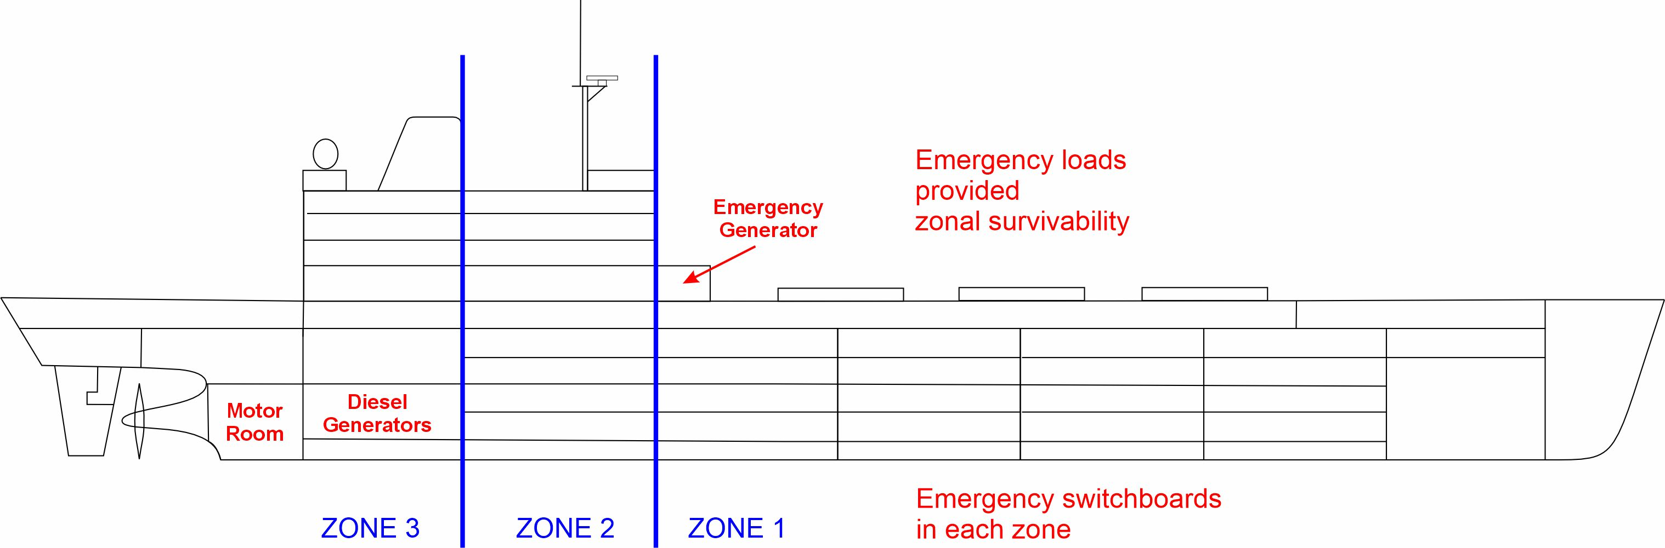
Evaluating zonal survivability
Examine damaged zone cases
  All individual zones
  All pairs of adjacent zones
With each damaged zone case
  Ensure sufficient generation and connectivity remains to power loads designated for zonal survivability
  Ensure sufficient loads remain in undamaged zones to achieve design threat outcome
Case | Damaged Zones
1 | 1
2 | 2
3 | 3
4 | 1 and 2
5 | 2 and 3

Slide 11
Evaluating compartment survivability
Extension of Zonal Survivability Analysis
Examine loads designated for compartment survivability in the damaged zones
  Ensure sufficient connectivity to undamaged zones
    Bus Transfer between two feeders
    Casualty power connection
  Ensure sufficient generation capacity in undamaged zones
Case | Damaged Zones
1 | 1
2 | 2
3 | 3
4 | 1 and 2
5 | 2 and 3

Slide 12
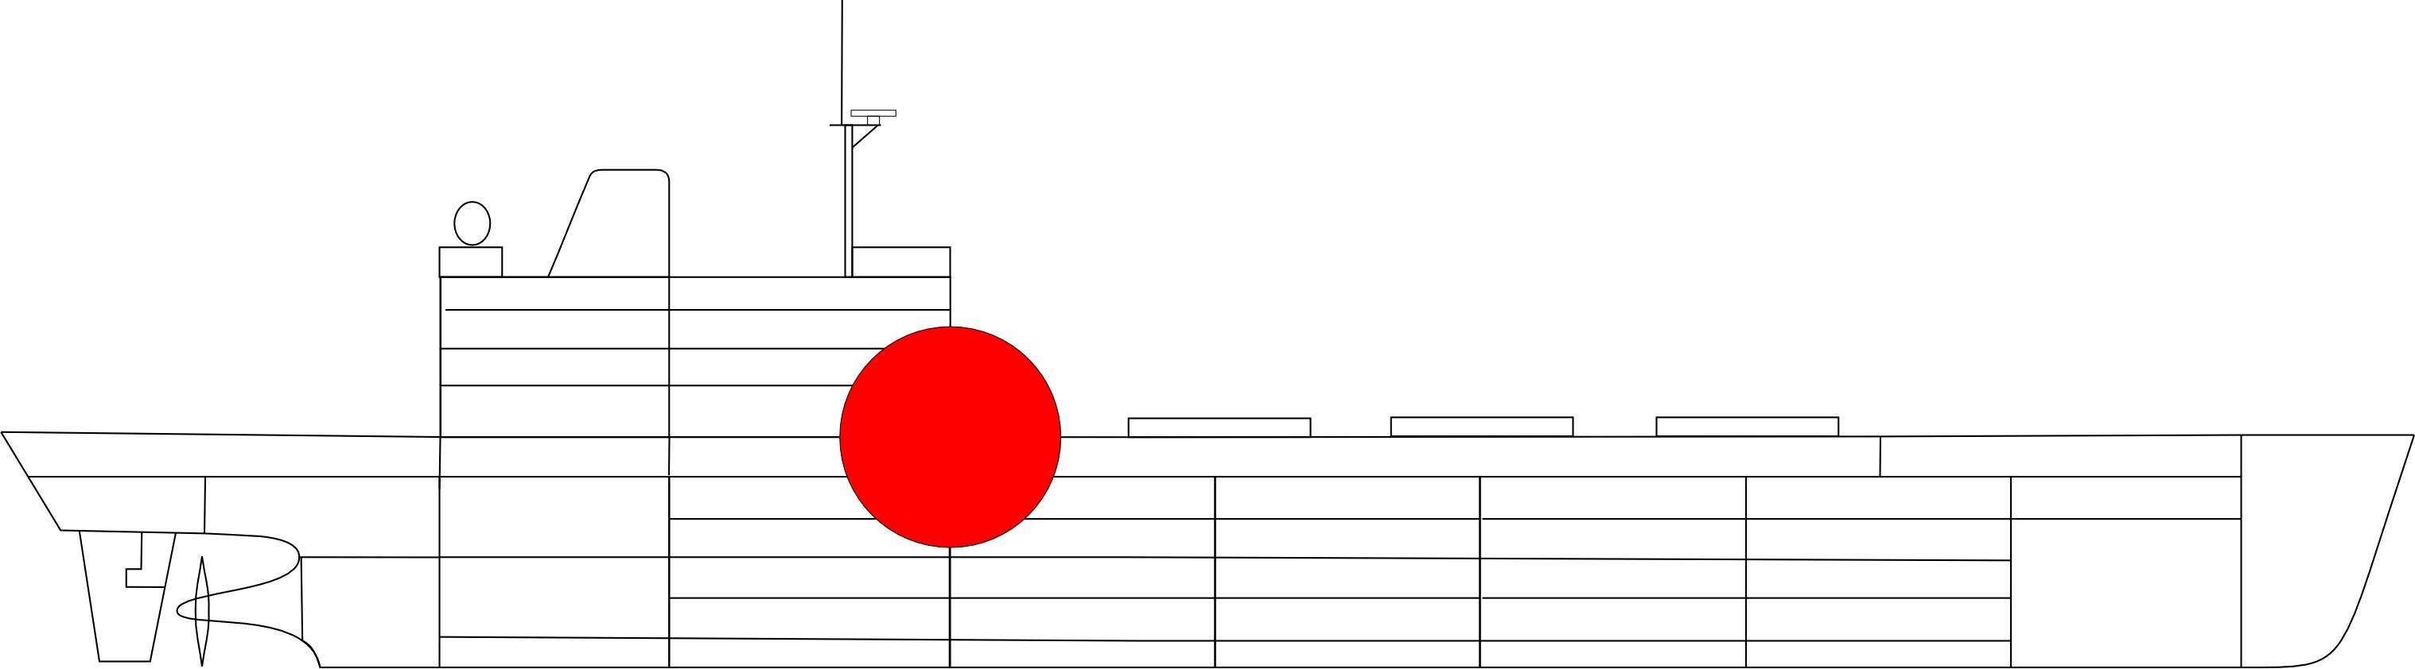
Evaluating non-zonal system survivability
A limited set of locations for damage are assumed.
Damage to equipment (and structure) from each design threat is assessed.
Overall impact of the damage on the ability to achieve design threat outcome is estimated.
Non-zonal system survivability assessment much more labor intensive than for zonal survivability.
Zonal survivability provides survivability via architecture.
Non-zonal systems provide survivability via detail design and analysis.

